Slide 1
Introduction to Crypto
1
Crypto Custodians & Bit-License
Kathryn Zhao
Denis Imaev

Slide 2
Introduction to Crypto
2
Why are crypto custodians necessary?
The safeguarding and administration of digital assets carries certain risks and operational burdens, which many asset owners are not well equipped to manage
Sophisticated security of digital assets is critical to providing a reliable and safe environment for increased institutional and retail investor adoption
Custodians provide a certain peace of mind to clients that assets are held safely and securely
Particularly important in relation to client asset segregation (risk mitigate) and maintenance of books and records
A dedicated, third-party custodian that takes no liquidity or market risk is a substantial client protection

Slide 3
Introduction to Crypto
3
Ownership Landscape
Institutional
Fidelity Digital Assets Survey found that:
52% of global institutional investors hold crypto
78% of institutions in the U.S. find crypto appealing, compared to 65% in 2019
Financial advisor adoption of crypto jumped from 23% to 43% over the past year in the U.S.

Slide 4
Introduction to Crypto
4
Ownership Landscape
Retail
Forbes reports that according to Cornerstone Advisors’ What’s Going On in Banking study:
20% of U.S. consumers hold some form of crypto
25% of Generation Z are crypto investors
30% of Millennials are invested in crypto
Of Americans who already hold Bitcoin or other cryptocurrencies, over 50% said they’d use a bank to invest in crypto if they could

Slide 5
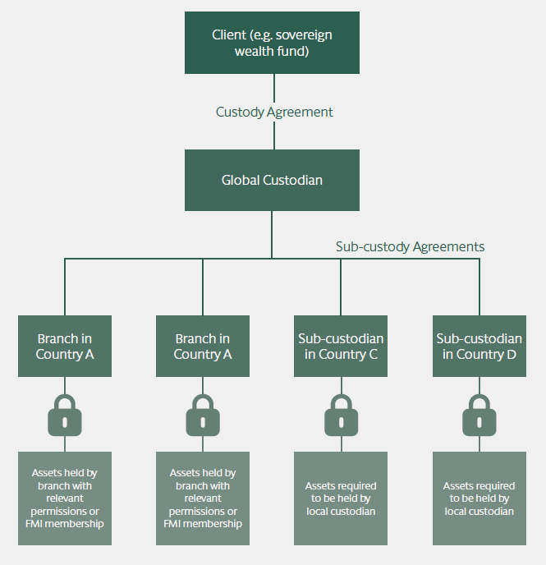
Introduction to Crypto
5
What do custodians do?
Safeguarding
Hold private keys
Controls, checks and balances
Settlement and reconciliations
Asset Services
Operational
Compliance
Voting, dividend, etc.

Slide 6
Introduction to Crypto
6
Crypto Custodians
Provide secure and accessible storage of investors’ and institutions’ assets
Offer services that allow clients to make use of their assets while they are under custody, like trading and staking
Perform administrative tasks, such as exercising rights pertaining to custodied assets
Has the necessary regulatory licenses or memberships required for the custodian to hold and/or transfer assets on behalf of its clients

Slide 7
Introduction to Crypto
7
Crypto vs. Traditional Custody: similarities
Custodians hold valuable assets for safekeeping
These assets are tangible objects like gold or stock certificates, or intangible assets like crypto
Qualified custodians must meet strict regulatory guidelines for keeping assets safe and secure
Custodians safeguard assets from external and internal threats
These include external theft, internal collusion, and human error
Movement of assets into or out of custody must be accounted for
Reliable record-keeping and reporting are core functions of a custodian

Slide 8
Introduction to Crypto
8
Crypto vs. Traditional Custody: differences
Digital assets are intangible data reflected on a distributed ledger in an encrypted form
There is no clearing entity to serve as a centralized record-keeper
The ownership is demonstrated by and transferred through the deployment of private keys
Many digital assets are designed to incentivize network participation
Traditional custody involves keeping assets far out of reach of potential attackers, but many digital assets are critical to ecosystem activity

Slide 9
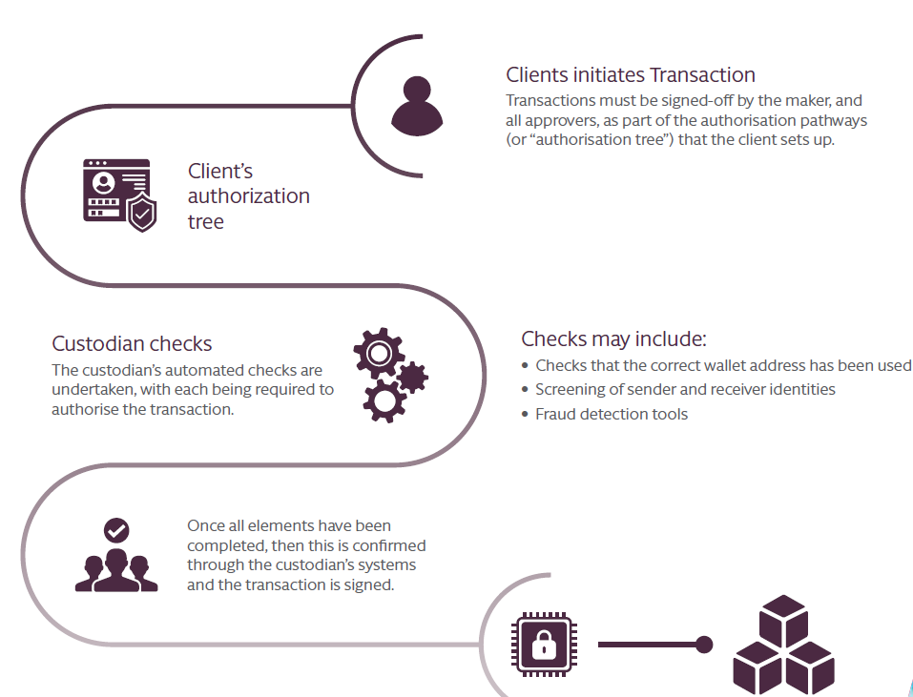
Introduction to Crypto
9
An example of a crypto transaction involving a custodian

Slide 10
Introduction to Crypto
10
Security of Digital Assets
The safekeeping of private keys while also making them accessible by clients
Digital assets require sophisticated security measures to keep assets safe
Wallets hold the keys, not the assets!
The ownership of assets are recorded on the chains themselves (the distributed ledger)

Slide 11
Introduction to Crypto
11
Types of Digital Asset Security
Product Security: creating many lines of defense
Strong authentication
Automated review systems
Trusted destination
Wallet choice and private key security
Physical Security
Operational (procedural) security
Location security

Slide 12
Introduction to Crypto
12
Types of Digital Asset Security (Cont.)
Network & Infrastructure Security
Cloud architecture
Cryptographic data transfer & storage
Penetration testing
Secure code lifecycle
Financial Security
Qualified custodians
Bank Secrecy Act (BSA) compliant: AML & KYC

Slide 13
Introduction to Crypto
13
Selection of Digital Asset Custodians
At an infrastructure level, there is no single decision more important than the choice of custodian
Choices:
Self-custody
Third-party custody
Multi-sig on a transaction
Multi-party computation (MPC)
Hardware security module (HSM)
Biometric authentication

Slide 14
Introduction to Crypto
14
Self-Custody
Self-custody remains a common choice for institutions
49% of institutional buy-side self-custody at least some digital assets
51% use a single or multiple third-parties for custody or a combination of third-parties and self-custody
Example: Ledger
Seeks to make self custody more accessible and convenient with a new wallet, incorporating touchscreen technology to redefine the experience of self custody
Its new Security Key app offers a cryptographic passkey capabilities as an alternative to conventional passwords

Slide 15
Introduction to Crypto
15
Multi-sig
Requires multiple private keys to authorize a transaction
The keys can be spread across several different systems, so if any single system is compromised, the owner’s assets are still protected from theft
Can use multi-sig to create and enforce an arrangement in which multiple people need to sign each transaction, preventing any individual from having total control over funds
M-of-N arrangement: N is the total number of authorized keys and M is the threshold number of keys required to authorize each payment
Inflexible and can be complex to manage

Slide 16
Introduction to Crypto
16
Multi-Party Computation
MPC increases security against hackers and rogue insiders by eliminating a single point of compromise
Offers important advantages over multi-sig in terms of flexibility, operational efficiency, and risk management
MPC splits a private key into “key shares” distributed across multiple physical devices, so a hacker cannot obtain the entire key by compromising a single device
Unlike multi-sig, the authorization threshold can be changed as long as all existing key “shareholders” agree to the change
Unlike multi-sig, there’s no need to create a new wallet and move funds into it once conditions change, hence no risk of losing funds

Slide 17
Introduction to Crypto
17
Hardware Security Module
Private keys are generated and permanently stored offline, on air-gapped hardware security modules (HSMs), providing greater security than cold storage
HMS aims to
Securely store cryptographic values (such as blockchain account seeds, keys, etc.)
Perform cryptographic operations such as decryption and signature
Ensure that the logic executed in the HSM is done as prescribed, and that it does not reveal sensitive information

Slide 18
Introduction to Crypto
18
How to select a custodian?
Type of services
Custodial wallet service
Private key management
Public-private keypair generation
Proof of ownership
Permission management

Slide 19
Introduction to Crypto
19
How to select a custodian?
Type of services (cont.)
Full digital custody service
Prime brokerage
Books, records, and reporting
Trade settlement
Position keeping
Financial crime protection
Security

Slide 20
Introduction to Crypto
20
How to select a custodian?
Type of services (cont.)
Full digital custody service (cont.)
Additional value-added services
Staking and yield generation
Trading venues and VASPs connectivity
Collateral management and financing
Governance

Slide 21
Introduction to Crypto
21
How to select a custodian?
Asset handling & control
Transaction signing
Asset transfer, deposit, and withdraw
Control lies with the custodian or the client or both
Type of wallet
Hot: always online
Warm: connect through intermediary device
Cold: always offline

Slide 22
Introduction to Crypto
22
Crypto Wallet
Digital assets wallets secure users’ private keys, allowing users to store and manage their crypto assets
Investors should seek a solution that combines accessibility with security
Warm wallets combine the transaction speed of hot wallets with an additional level of security, like cold wallets
Not all digital asset institutions require the same balance of attributes. A crypto business that trades frequently may prioritize the speed of a hot wallet, while an investor who plans to hold assets for the long-term may value the security of a cold wallet above all

Slide 23
Introduction to Crypto
23
Type of Wallet
Exchanges
Provide online access to assets
Vulnerable to attack
Software wallets
Enable storage of private keys locally on a mobile or desktop device
Vulnerable to attack
Paper wallets
Pieces of paper that hold written keys or seed phrases
Prone to loss, damage, and error
Consumer hardware wallets
Specialized hardware that stores private keys and signs transactions

Slide 24
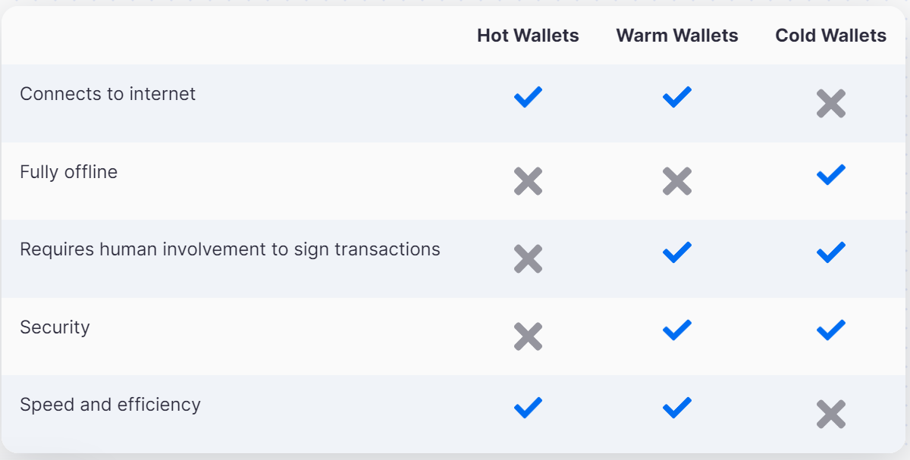
Introduction to Crypto
24
Wallet Properties

Slide 25
Introduction to Crypto
25
How to select a custodian?
Security and risk management
Key/wallet management: Japan’s case
Client asset verification
Other pre-trade checks
Audits/certification
Insurance coverage/Level of reserve
On-chain forensics/monitoring
Other risk management protocols

Slide 26
Introduction to Crypto
26
How to select a custodian?
Operational Approach
If the custodian has segregated the assets of each client, then this presents a higher level of protection for clients, though may result in certain operational inefficienciesIn contrast, certain custodians may employ an omnibus model which offers operational efficiencies but may increase the risk for clients of either a security breach or custodian failure or insolvency
An assessment to balance this risk with the potential operational and commercial benefits should be undertaken
Existing principles relating to the evaluation of critical outsourced service providers may prove to be a useful tool
Special considerations should be paid to the custodian’s approach to information security, business continuity, and disaster recovery

Slide 27
Introduction to Crypto
27
How to select a custodian?
People/Expertise
An early and primary objective of the administrator would be to secure people with sufficient technical expertise who are able to assist with retrieval and deployment of private keys (e.g., in situations like insolvency)
Market penetration
Number of institutional clients
Number of tokens supported
Asset under custody (AUC)

Slide 28
Introduction to Crypto
28
How to select a custodian?
Post Trade Services
Digital Asset Settlement Network
Reporting Service
Custodian Registration
Founding year
Registration timeline
Fee Policy
Regulatory Compliance (future-proof)

Slide 29
Introduction to Crypto
29
Expectations for Digital Asset Custody
Institutions do not have to sacrifice usability for security
API integration with tools of your choice
Customized permission policies
Analytics
Holistic view of account activity and behavioral data
Automated outlier detection

Slide 30
Introduction to Crypto
30
Examples of Digital Custodians
BitGo
Zodia (HSM)
Copper
Etana
Anchorage (HSM)
Prime Trust
Fireblocks
Metaco

Slide 31
Introduction to Crypto
31
MiCA on Custodians
Custodians of crypto-assets are classified as crypto-asset service providers (CASPs) and required to obtain regulatory authorization with the relevant national competent authority under MiCA
CASPs are defined as safekeeping or controlling, on behalf of third parties, crypto-assets or the means of access to such crypto-assets, where applicable in the form of private keys
As CASPs, crypto-asset custodians are subject to general requirements (which apply to all CASPs) as well as custody-specific requirements under MiCA

Slide 32
Introduction to Crypto
32
BNY Mellon Exemption
SAB 121: financial institutions are required to list crypto assets held in custody on their balance sheets as liabilities, which has effectively barred banks from offering crypto custody services
BNY Mellon received a “variance” from the SEC’s SAB 121 accounting guidelines, which will allow BNY Mellon to provide institutional custody of digital assets without listing them on their balance sheet as liabilities
This exemption could pave the way for other ‘trad-fi’ banks to offer crypto custody services: think Coinbase!

Slide 33
Introduction to Crypto
33
FalconX, Binance and the Curious Case of 1.35M Missing SOL
Crypto brokerage FalconX had 1.35 million Solana (SOL) in its possession since 2021, but didn't know who they belonged to
Now worth around $190 million, the tokens turned out to be Binance’s
Ideal scenario:
Trading venues run matching engines and should not hold clients’ assets
Custodians safeguard clients’ assets
Market value should be further validated and reported by an independent fund administrator

Slide 34
Introduction to Crypto
34
BitLicense Background
The very first BitLicense was granted in 2015 to mixed reactions
Regarded as rather onerous
Cryptocurrency businesses were subjected to more stringent regulations than traditional ones
After significant pushback and complaints, New York regulators implemented a more “liberal” framework on June 25, 2020
Given the difficulty of obtaining a BitLicense, New York has seen cryptocurrency start-ups leave the state and relocate to other jurisdictions that are viewed as friendlier and more conscious of the fledging manager’s limitations

Slide 35
Introduction to Crypto
35
BitLicense: the Golden Ticket
To conduct virtual currency business activity in New York, entities can apply for a BitLicense under the New York Banking Law
New York is the first to adopt cryptocurrency-specific license legislation
The BitLicense, a historic cryptocurrency law, is a terminology for a virtual currency license regulated by the New York Department of Financial Services (NYDFS) under regulations established for businesses or individuals engaging in business activity concerning virtual currency in New York
Seeks to create a regulatory framework for cryptocurrency-related activities
Provides operators with legal certainty and acknowledged legitimacy

Slide 36
Introduction to Crypto
36
Virtual Currency Business Activity
Virtual Currency Business Activity is the conduct of any one of the following types of activities involving New York or a New York resident:
Receiving virtual currency for transmission or transmitting virtual currency, except where the transaction is undertaken for non-financial purposes and does not involve transfer of more than a nominal amount
Storing, holding, or maintaining custody or control of virtual currency on behalf of others
Buying and selling virtual currency as a customer business
Performing exchange services as a customer business
Controlling, administering or issuing a virtual currency

Slide 37
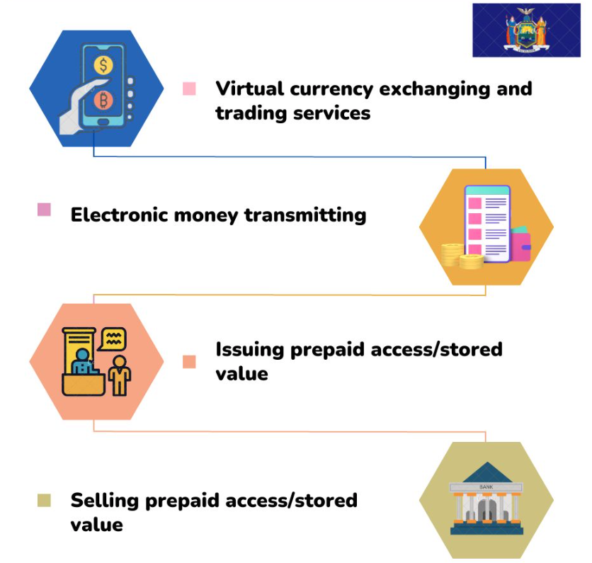
Introduction to Crypto
37
Authorized Activities

Slide 38
Introduction to Crypto
38
BitLicense Application Process
Incorporation of a domestic entity in New York or respective state of choice
Opening a corporate bank account suitable for cryptocurrency operations
Drafting of policies and documents for the application, including the AML compliance program, business plan, business volume estimate, and financial projections
All companies require a Chief Compliance Officer
Applying for a surety bond
The current NYDFS requirement for the surety bond is $500K

Slide 39
Introduction to Crypto
39
BitLicense Application Process
Submission of application to NYDFS
Through the web-based system called Nationwide Multistate Licensing System and Registry (NMLS)
The process can take, on average, three years
Obtaining a BitLicense is a serious undertaking that will involve costs and resources related to the application and ongoing compliance, including minimal capital requirements, surety bond or trust account and full reserves

